Slide 1
Caching Basics, Strategies, and Modern Web Usages
K M Fatin Ishraq
Associate Software Engineer
Cefalo Bangladesh Ltd
Sumonta Saha Mridul
Trainee Software Engineer
Cefalo Bangladesh Ltd
Sanzida Afrin Promi
Trainee Software Engineer
Cefalo Bangladesh Ltd

Slide 2
An Overview of HTTP Caching
Sanzida Afrin Promi
Trainee Software Engineer
Cefalo Bangladesh Ltd

Slide 3
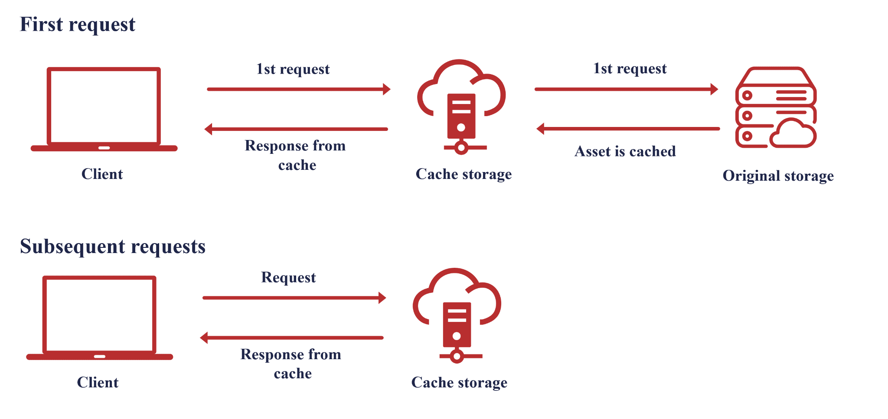
What is Caching?
Caching is the process of storing copies of given resource temporarily in a cache .

Slide 4
Web Caching
Web caching involves storing copies of web files, like HTML pages or images, on a user's device or intermediary servers.
Of all the ways to improve website performance, caching is the most important one.

Slide 5
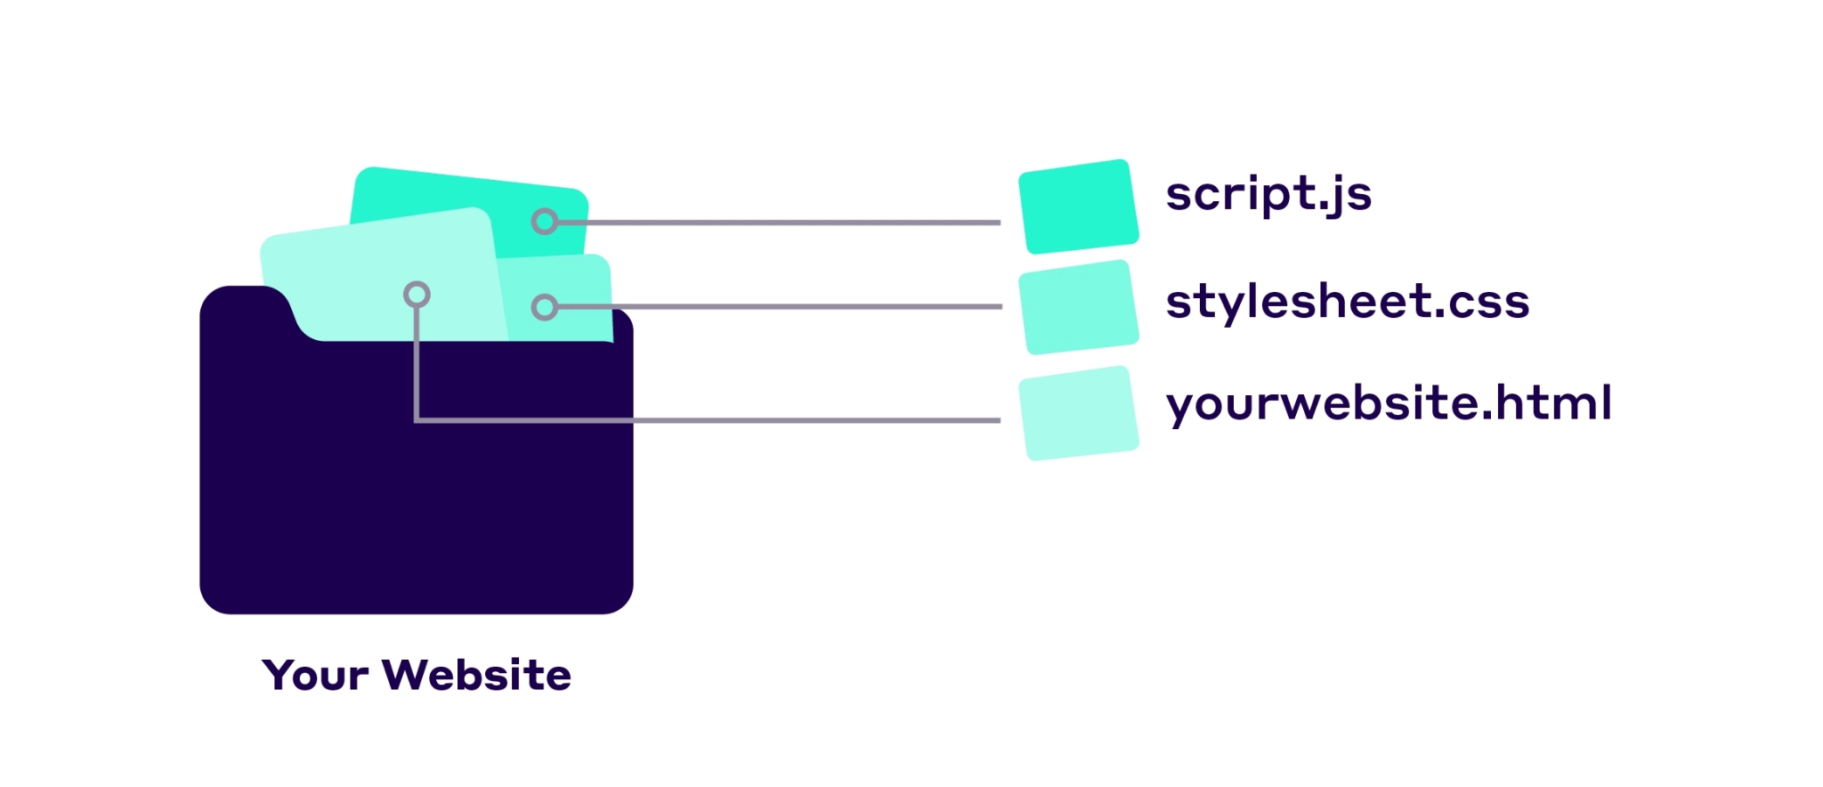
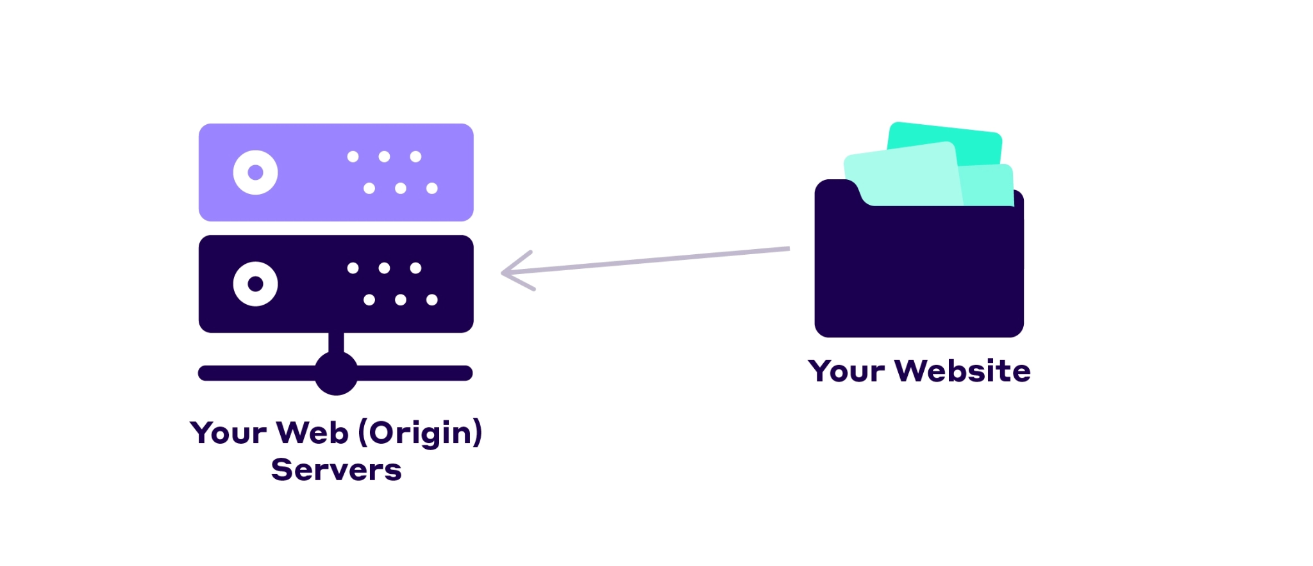
How the Web Works?
.

Slide 6
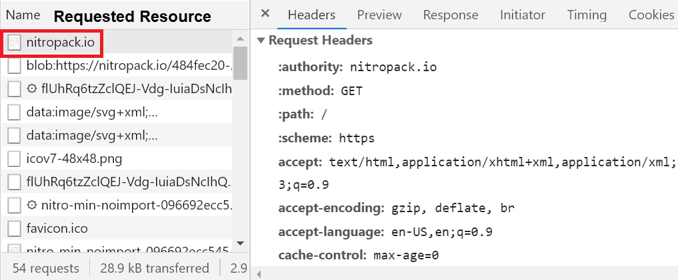
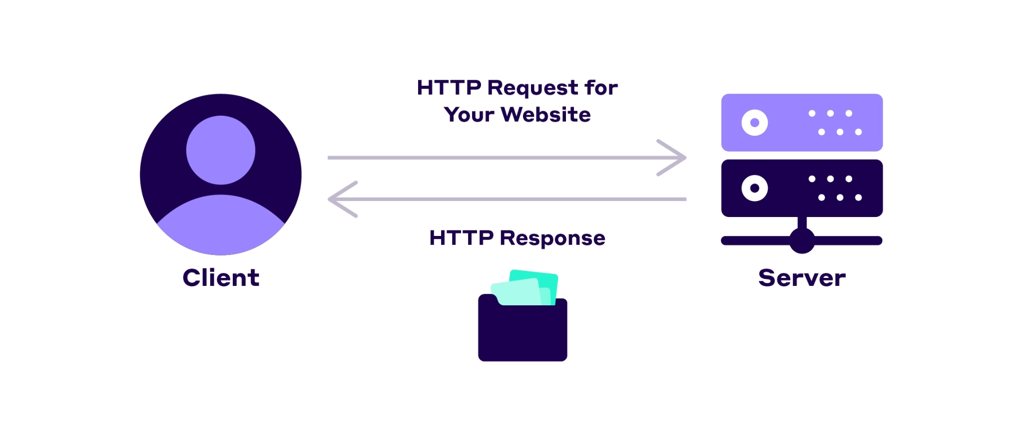
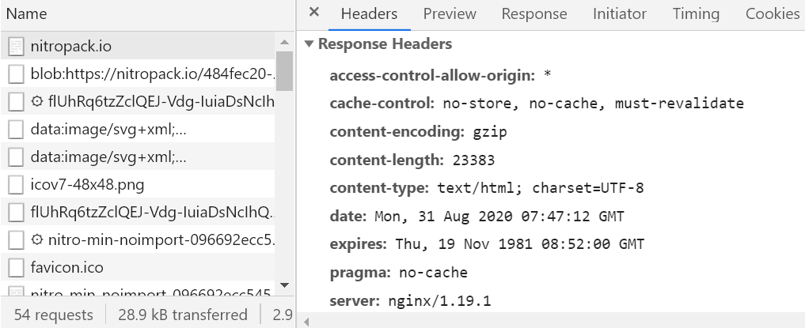
How the Web Works?

Slide 7
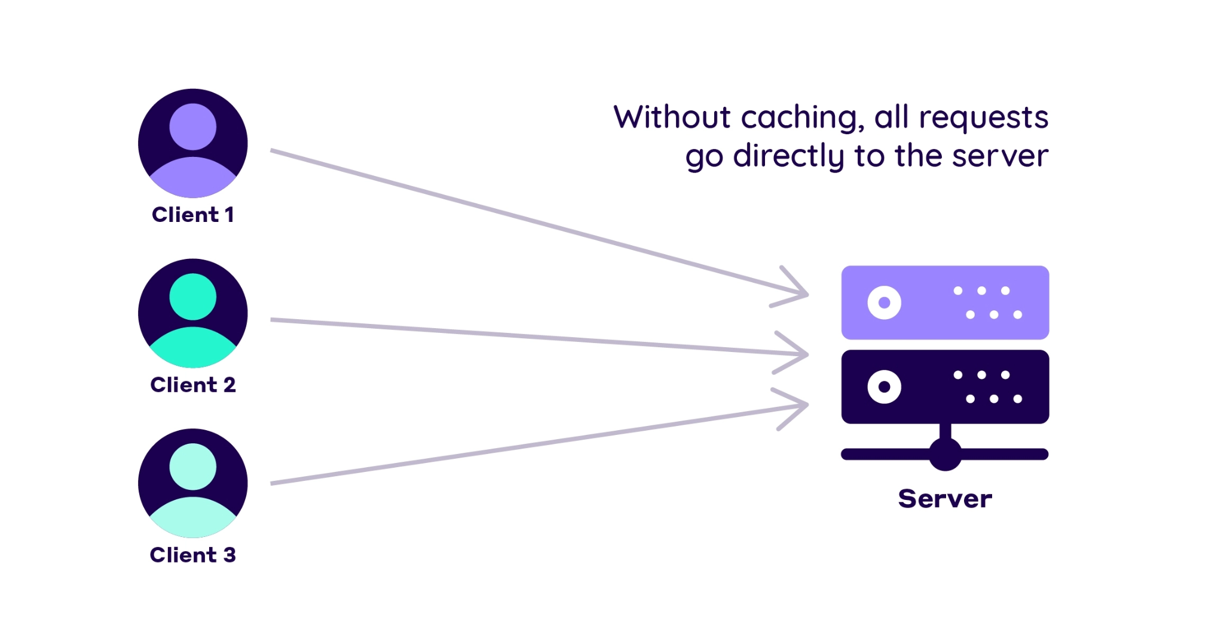
Why Every Web Service Needs a Caching Layer?
Origin server has to handle all incoming requests.

Slide 8
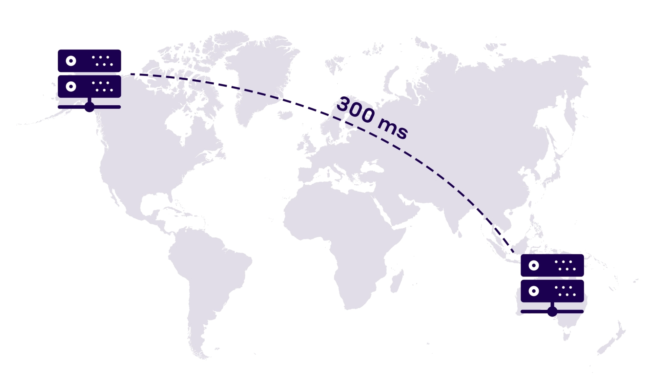
Why Every Web Service Needs a Caching Layer?
Web server is pretty far away from most visitors
Increases the latency and makes website slower
Repeat visitors have to re-download the same files every time,a massive waste of bandwidth.

Slide 9
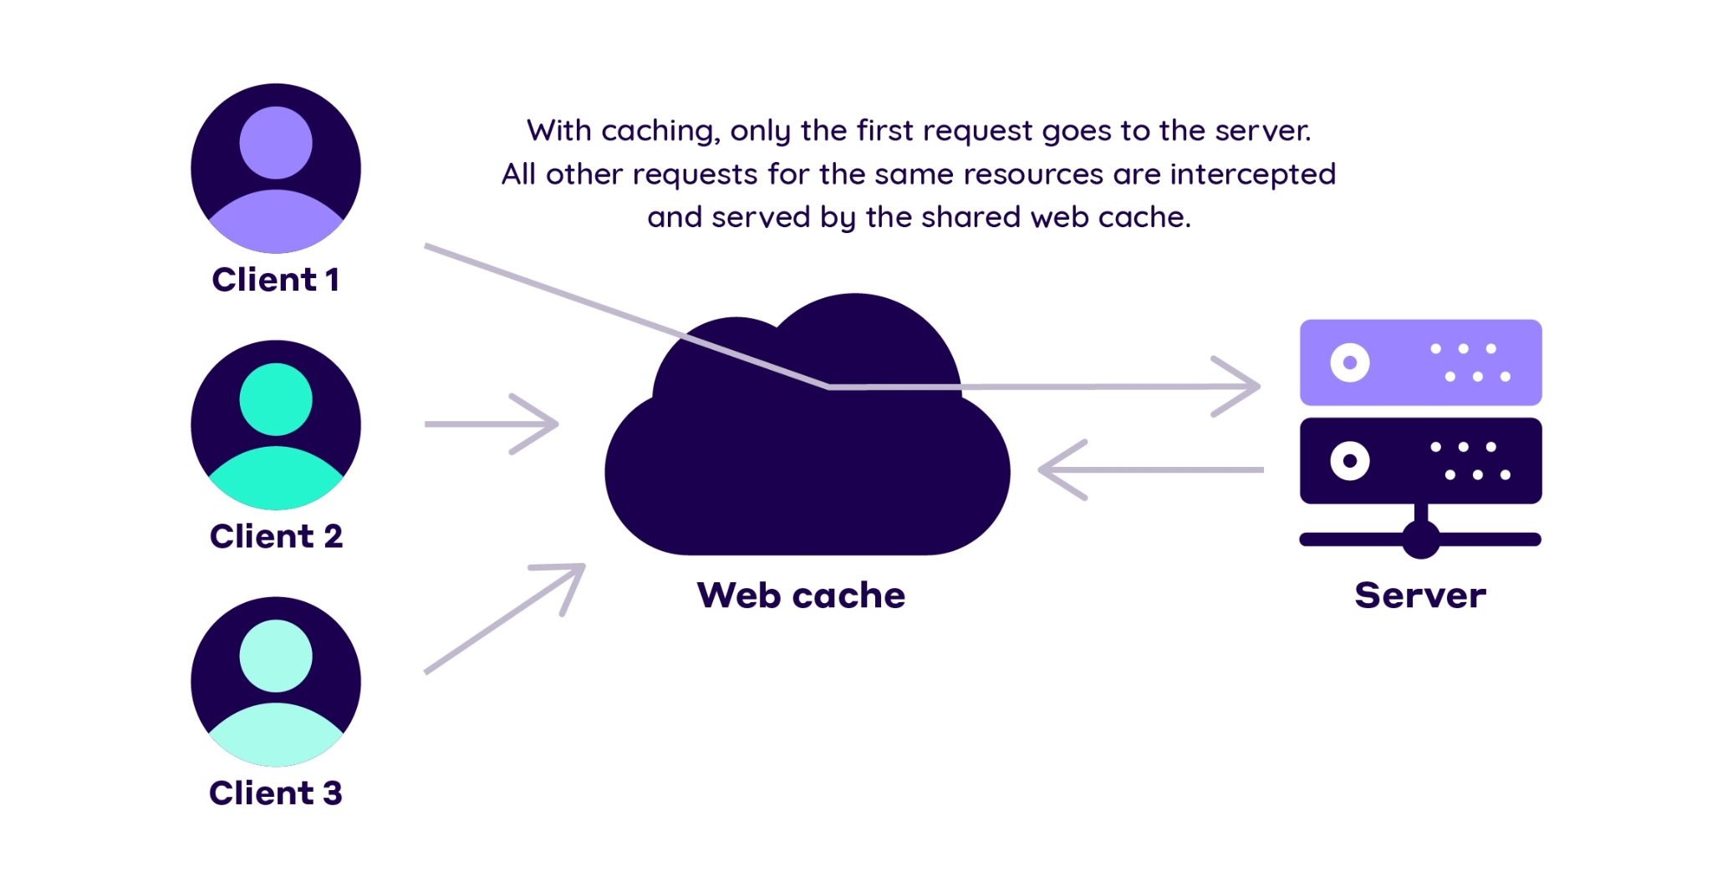
How Web Caching Works?
Storing a copy of your website’s resources in a different place called a web cache.
Sit between the origin server and the user and save HTTP responses - HTML documents, images, CSS files, etc.

Slide 10
Types of Web Caching
Two crucial distinctions of web caching:
Browser caching
Proxy server caching

Slide 11
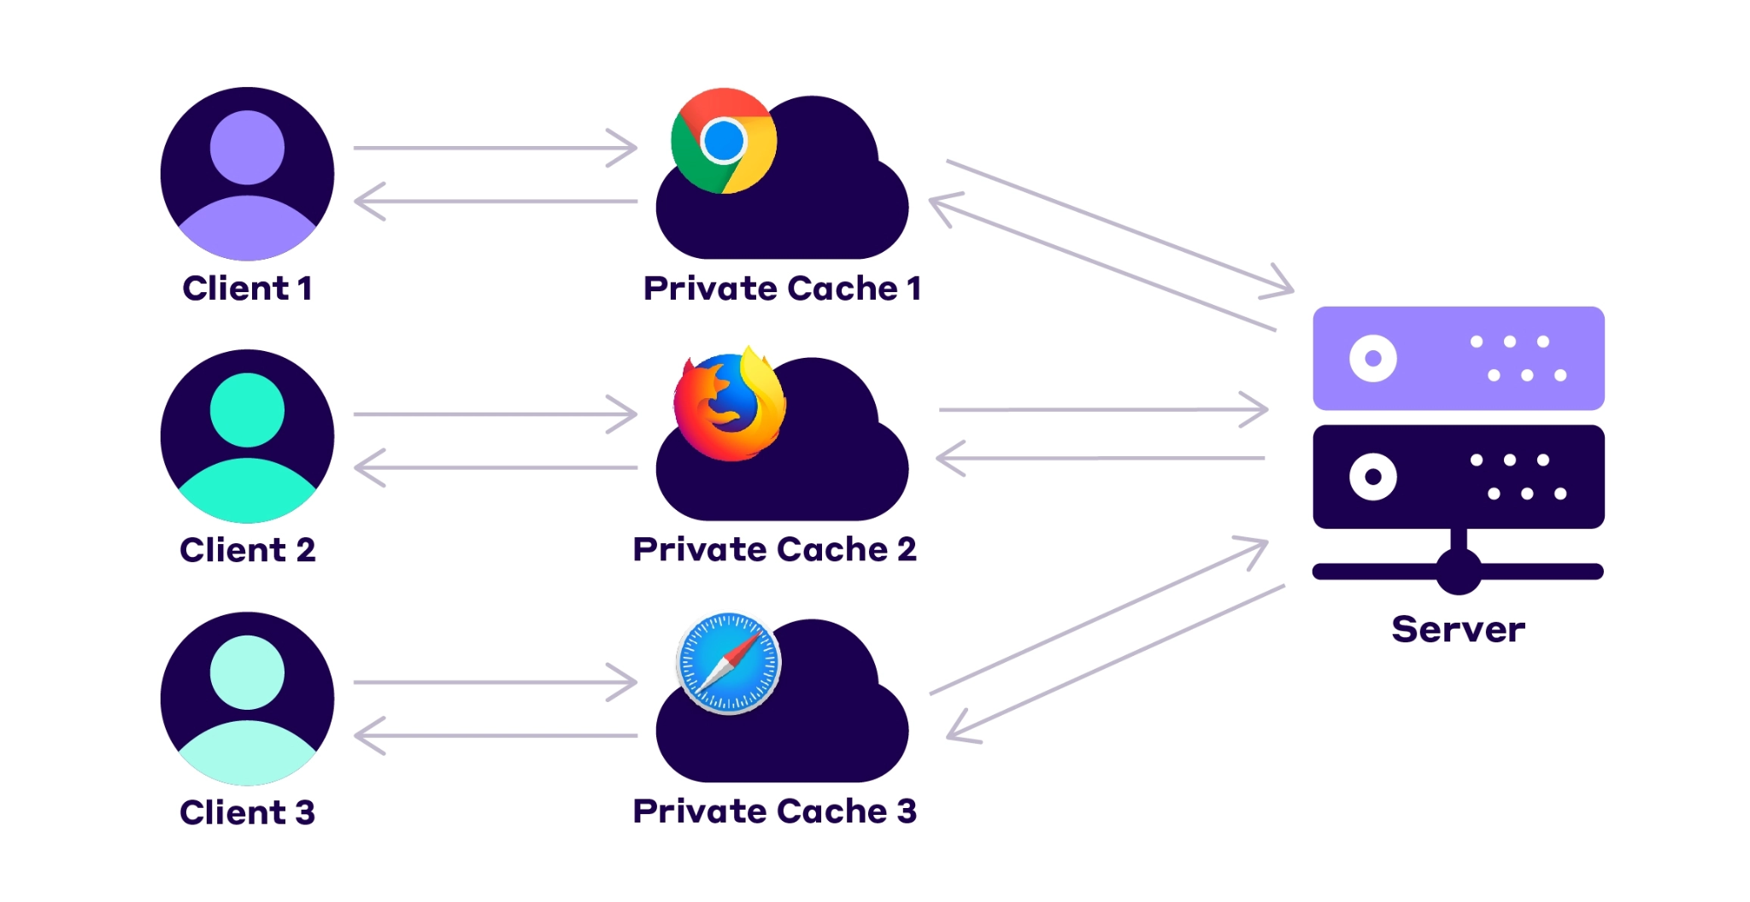
Browser Caching
A temporary storage area in memory or on disk
Dedicated to a single user
Holds the most recently downloaded Web pages
Typically cache what are known as "static assets"

Slide 12
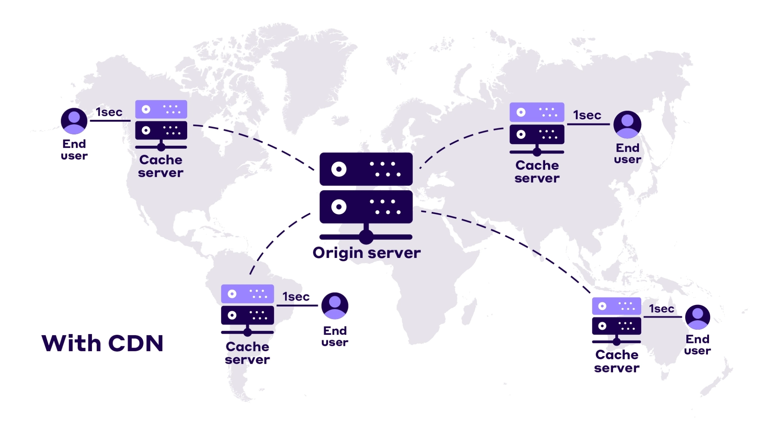
Proxy Server Caching
Proxies act as intermediaries between the client and the origin server.
Interpret and respond to requests on behalf of the original server

Slide 13
Proxy Server Caching
Known as shared or Public caches
Responses to be reused by more than one user
Popular resources are reused a number of times

Slide 14
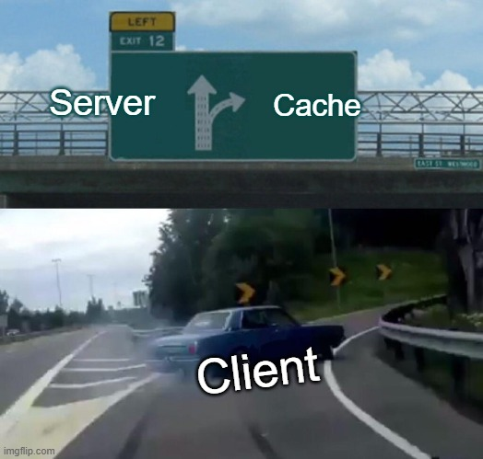

Slide 15

Benefits of caching
Reduce redundant data transfers
Reduce latency or distance delays
Reduce demand on origin server
Hide network failures

Slide 16
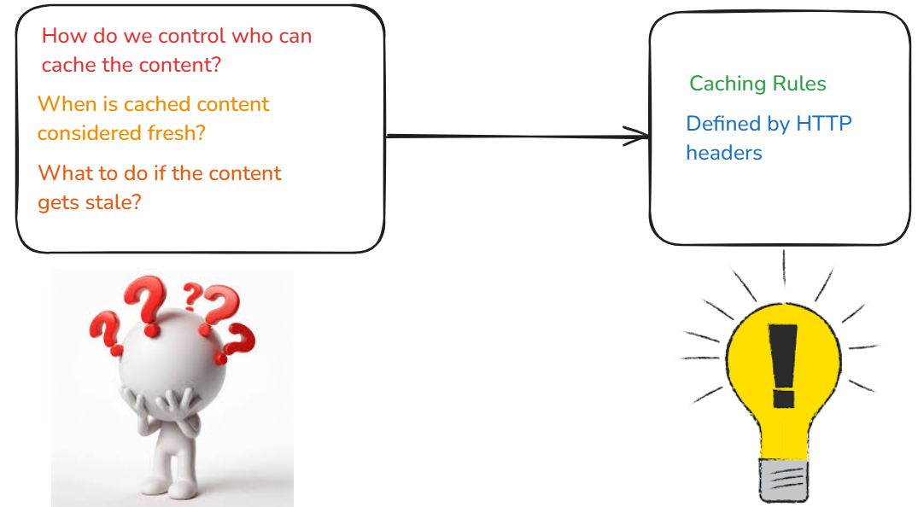

Slide 17
HTTP Headers Related to Caching
Cache-Control
Pragma
Range
Expires
Age
If-Modified-Since
If-None-Match
If-Unmodified-Since
If-Match
ETag
Last-Modified
Vary
Warning

Slide 18
Cache-Control Directives
public
private
no-cache
no-store
Must-revalidate
proxy-revalidate
max-age=<seconds>
s-maxage=<seconds>
immutable
stale-while-revalidate=<seconds>
stale-if-error=<seconds>
max-stale[=<seconds>]
min-fresh=<seconds>
only-if-cached

Slide 19
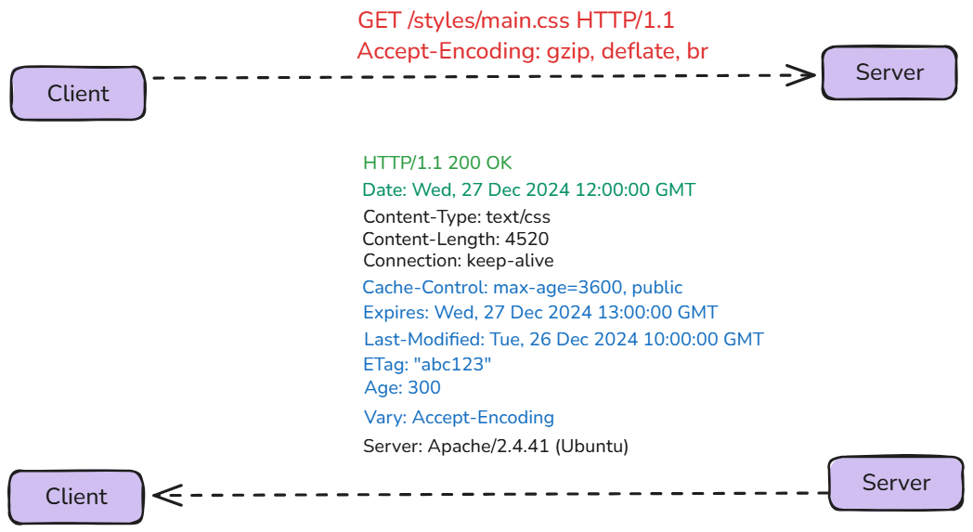

Slide 20





How do we control who can cache the content?
Cache-Control: public
Cache-Control: private

Slide 21
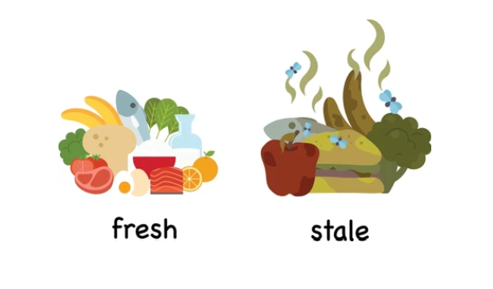
Life Cycle of Cached Contents
Fresh : response is still valid and can be reused
Stale : response has already expired.

Slide 22
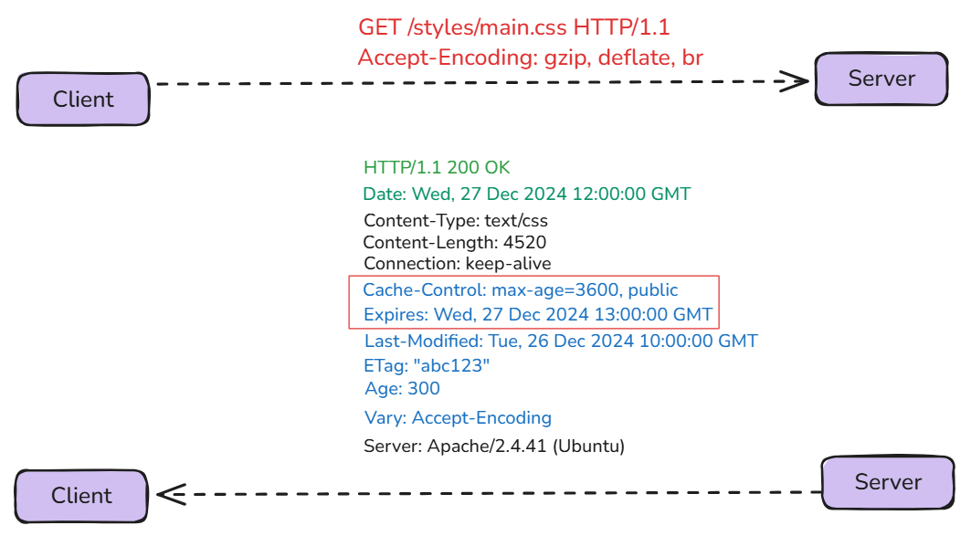
A Content : Fresh or Stale?
Fresh:
Elapsed time is within the max-age duration.
Current date is within the Expires value.
Stale:
Elapsed time exceeds the max-age duration.
Current date is past the Expires value.

Slide 23
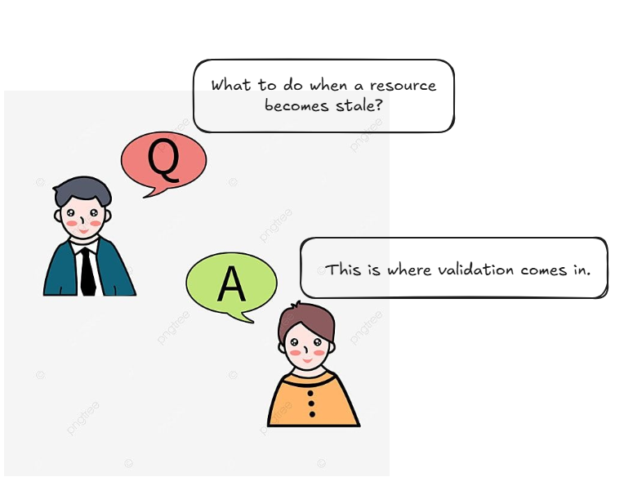

Slide 24
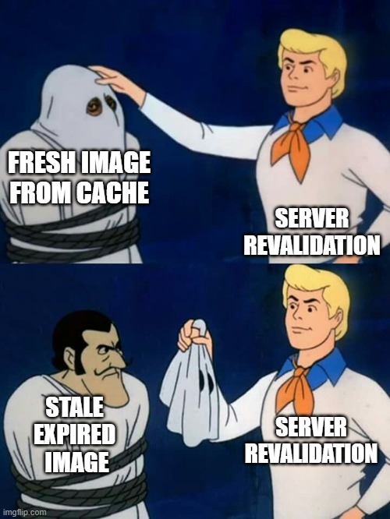
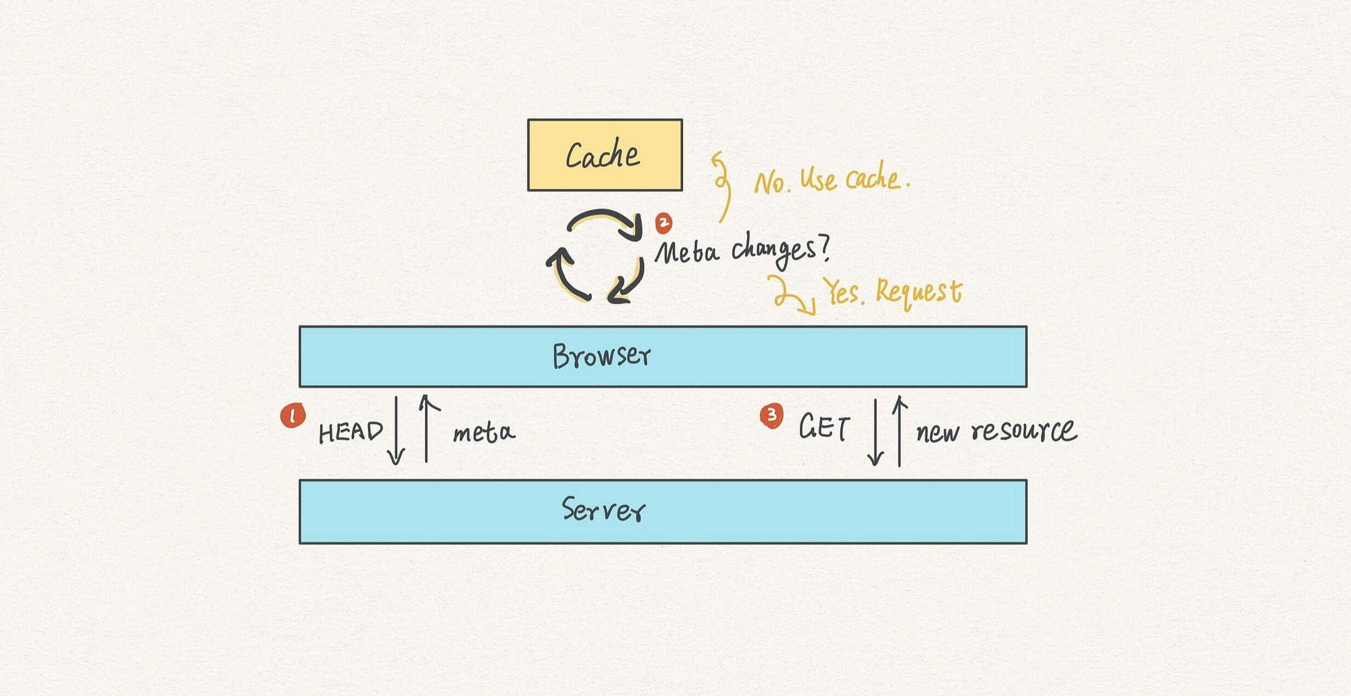
Server Revalidation

Slide 25
How is validation performed for cached resources?
Using the Last-Modified and If-Modified-Since headers
Using the Etag and If-None-Match header

Slide 26
Server Revalidation : Why needed?
A cached document expiration doesn’t mean it’s different from the origin server
Cache needs to ask the origin server whether the document has changed
Unmodified Cached content can be reused.

Slide 27
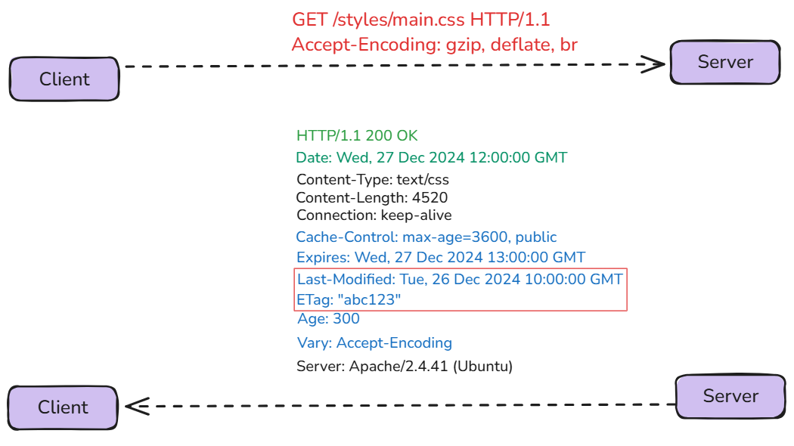
Revalidation
Initial Request

Slide 28
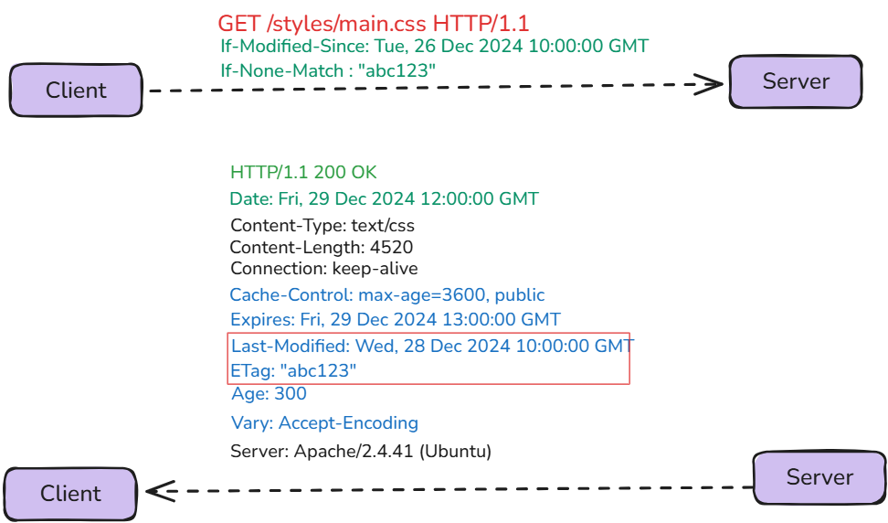
If-Modified-Since : true
If-None-Match : true

Slide 29
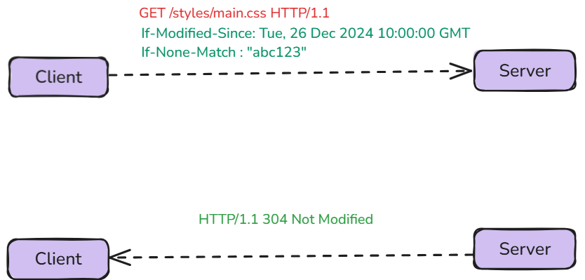
If-Modified-Since : False
If-None-Match : False

Slide 30
Force Revalidation
To always fetch the latest content from the server.
By adding Cache-Control: no-cache to the response.

Slide 31
Don’t Cache
When dealing with
Sensitive data
Dynamic or frequently-changing data
Security concerns
By adding Cache-Control: no-store to the response.

Slide 32
Avoiding Revalidation
Cache-Control: max-age=31536000, immutable
The immutable directive explicitly indicates that revalidation is not required because the content never changes.

Slide 33
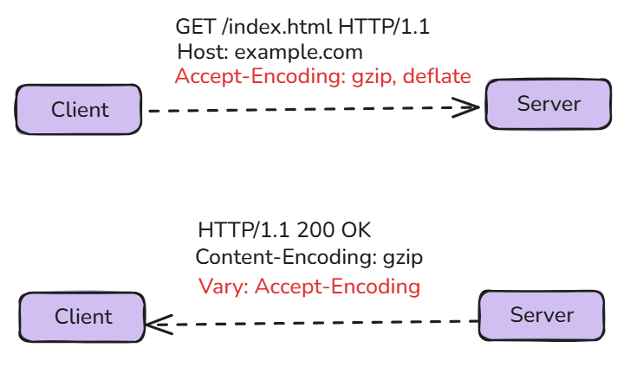
Vary
Initial Request-Response

Slide 34
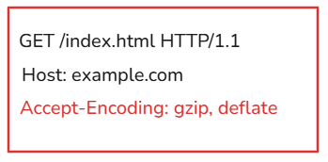
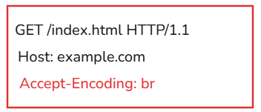
Vary
Subsequent Request (Matching Accept-Encoding)
The response will be served from the cache
Subsequent Request (Different Accept-Encoding):
The response will not be served from the cache

Slide 35
Deletion of Cached Contents
Manual Deletion: Users can clear browser cache via settings.
Cache Expiry: Content is replaced or revalidate when it exceeds max-age or Expires.
Cache Invalidations: Developers use techniques like versioned URLs to force deletion.
No-Store Directive: Prevents caching entirely, avoiding stored content

Slide 36
Cache Busting
When: Done when updated resources need to replace cached ones.
Why: Prevents users from accessing stale content.
How: Use versioned URLs (e.g., file-v2.js) or query strings (e.g., file.js?v=2).
Purpose: Ensures users get the latest updates seamlessly.

Slide 37
What Happens When Cache-Control Information is Missing?
Browsers use heuristics (rules or algorithms) to decide how long to keep a cached resource, often based on the last-modified date or the age of the cached resource. This is called Heuristic Caching .

Slide 38
Some Best Practices While Caching
If both Expires and Cache-Control: max-age are available, max-age is defined to be preferred.
Using Cache-Control:max-age=3600,must-revalidate,proxy-revalidate together
Use of kitchen-sink headers to deal with the outdated implementation.
Cache-Control: no-cache,max-age=0, must-revalidate
Cache-Control: no-store,no-cache,max-age=0, must-revalidate

Slide 39
Some Best Practices While Caching
Use ETag for dynamic or frequently changing resources to ensure precise, content-based validation.
Use Last-Modified for a simple solution when resource modification times are reliable and consistent.

Slide 40
Server Side Caching
Strategy
A Quick Overview of
Sumonta Saha Mridul
Trainee Software Engineer
Cefalo Bangladesh LTD.

Slide 41


Slide 42
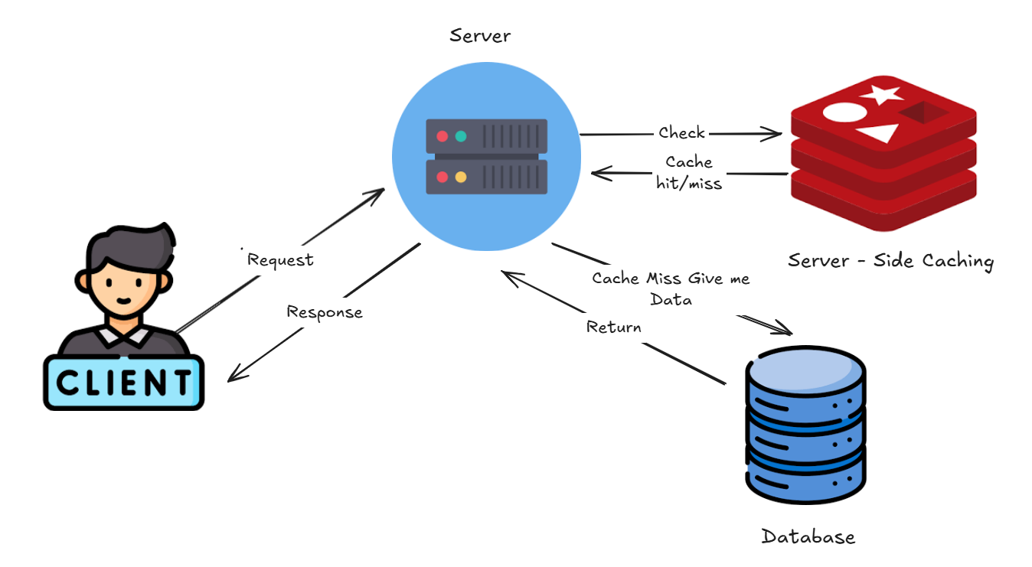
What is Server Side Caching?
Server-side caching generally refers to the cache layer positioned between the server's application logic and the database.

Slide 43
What is Cache Hit & Cache Miss?

Slide 44
What is Cache Hit?
Requested data is already stored in the cache
The cache quickly returns the data without needing to fetch it from the original source, saving time and resources.

Slide 45
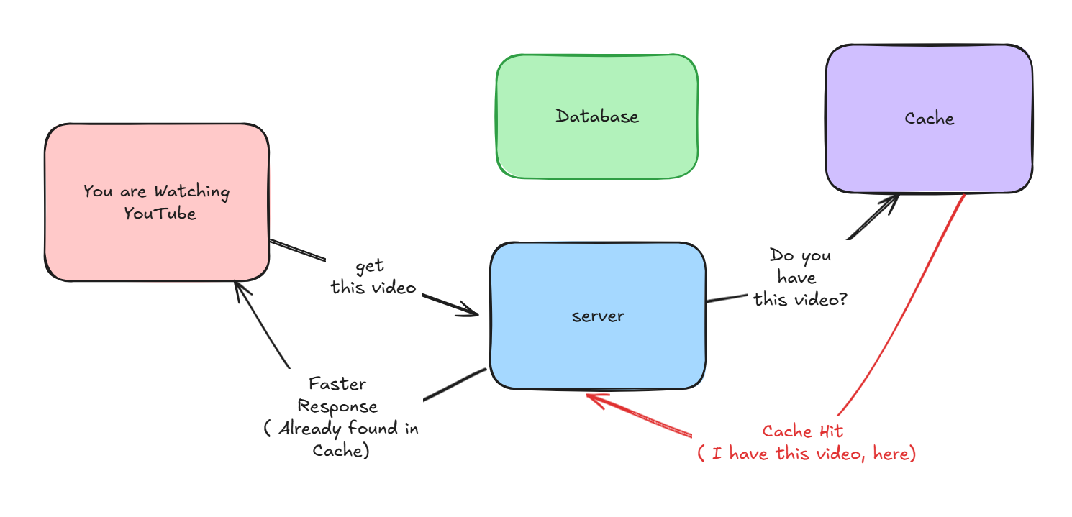
What is Cache Hit?

Slide 46
What is Cache Miss?
Requested data is not stored in the cache
The system fetches the data from the original source (like a database or server), which takes more time.

Slide 47
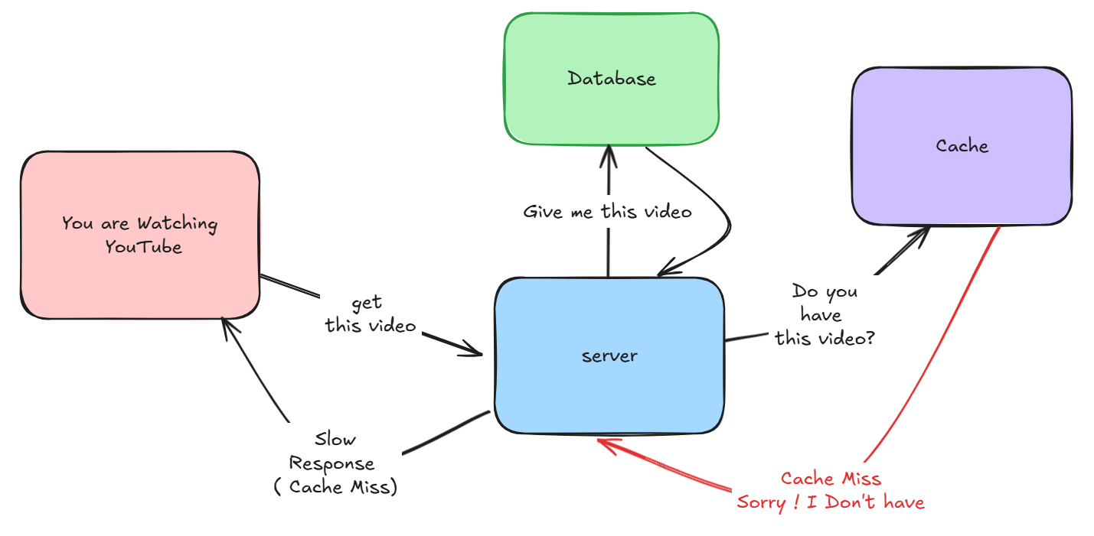
What is Cache Miss?

Slide 48
Cache Aside
Caching Strategy

Slide 49
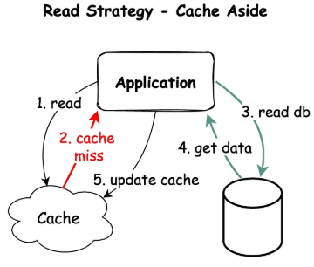
Cache Aside Strategy
First check cache for data
Cache Hit ! Return data to Client
Cache Miss !
Server Fetch data from DB
Store data in Cache
Return data to client

Slide 50
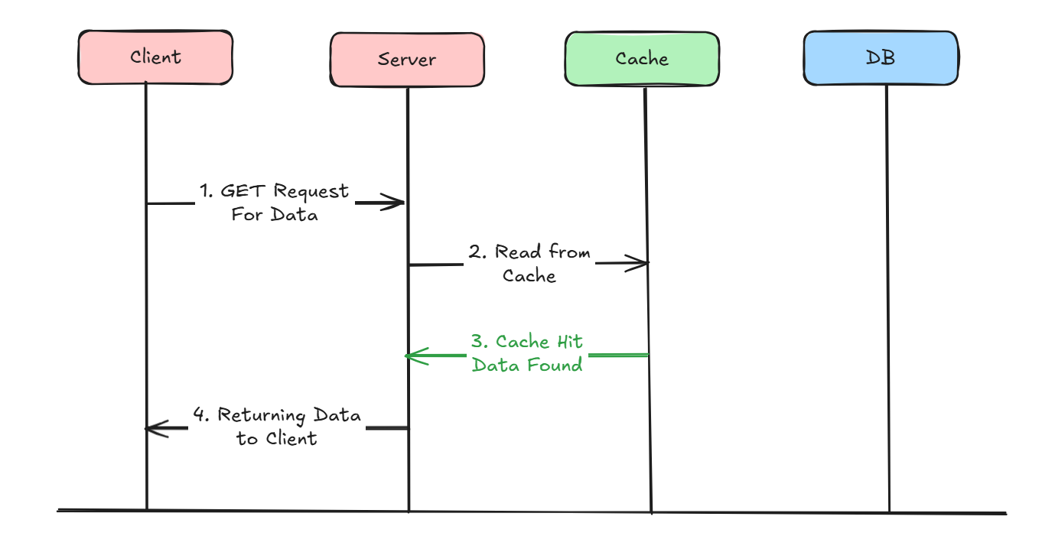
What happens in Cache Hit?

Slide 51
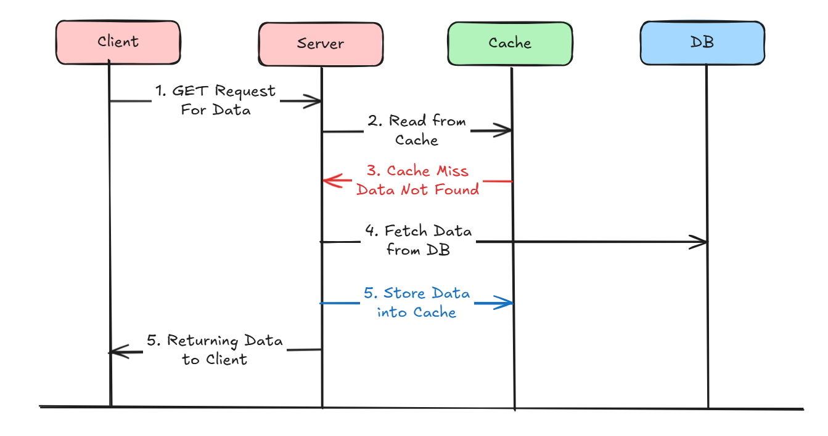
What happens in Cache Miss?

Slide 52
Cache Aside : Advantages
Good Approach for Heavy Read applications
Even Cache is down, request will not fail, It will directly fetch from data.
Cache document data structure can be different that data present in DB

Slide 53
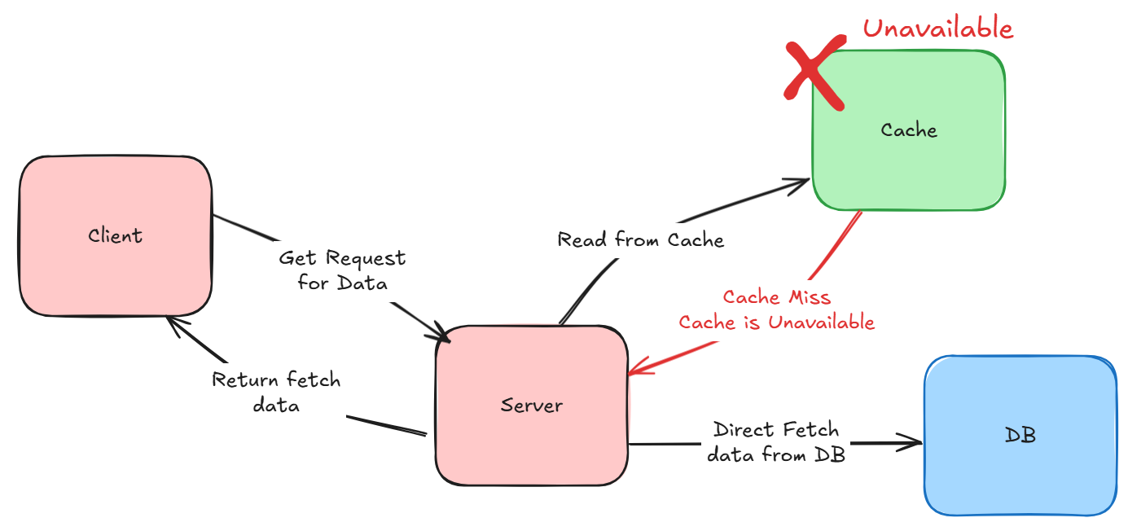
Even Cache is down, request will not fail, It will directly fetch from data.

Slide 54
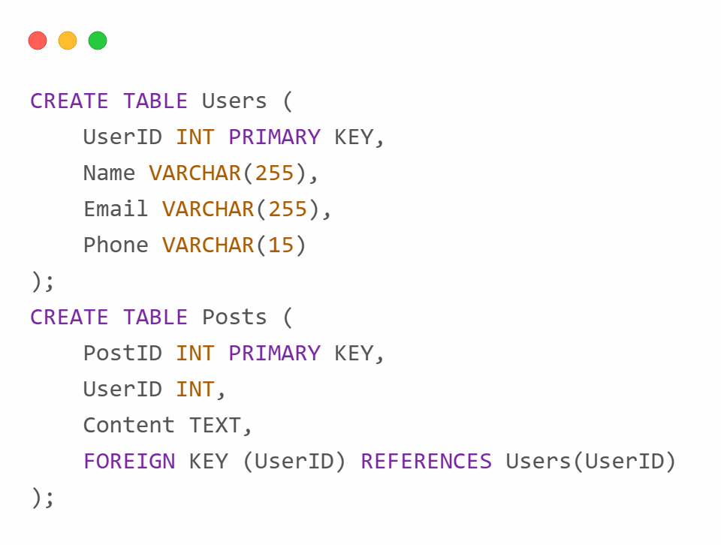
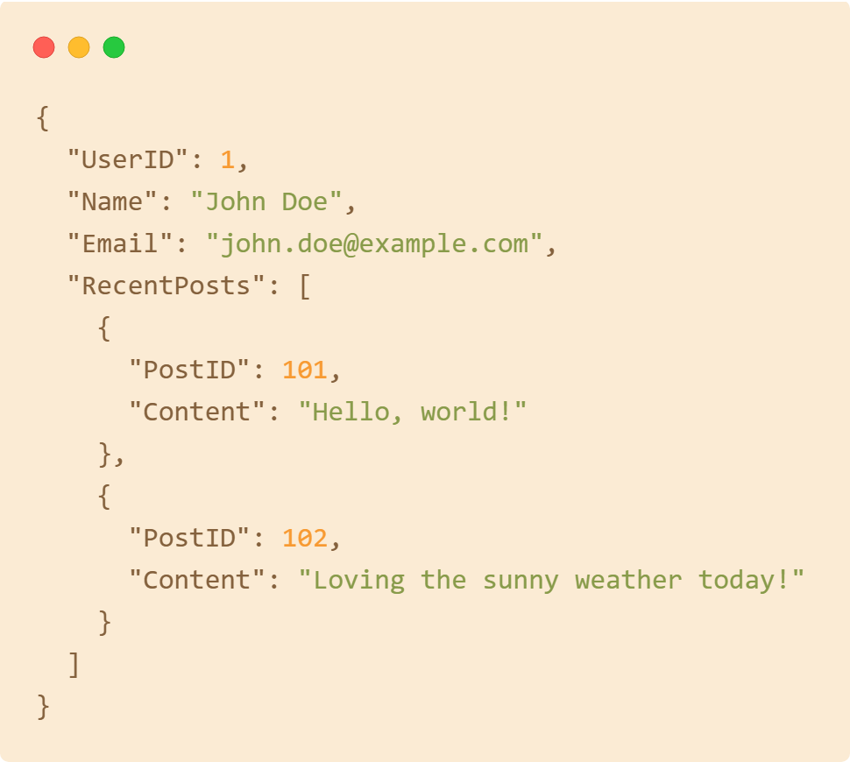
Cache document data structure can be different that data present in DB
Database (Structured for Storage)
Cache (Optimized for Access)

Slide 55
Cache Aside : Cons
Write Only Method will always directly write to DB
For new data read, there will always be Cache - Miss first.
If appropriate caching is not used during write operation, there is a chance of inconsistency between Cache and DB

Slide 56
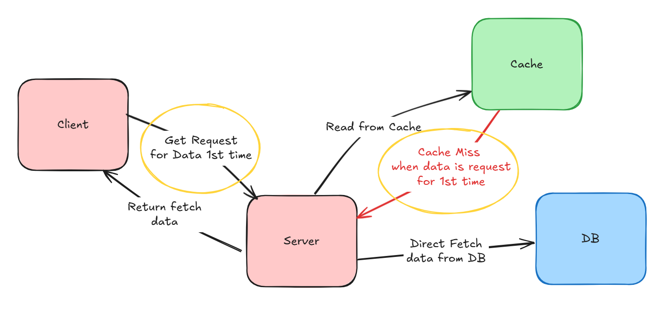
For new data read, there will always be Cache - Miss first.

Slide 57
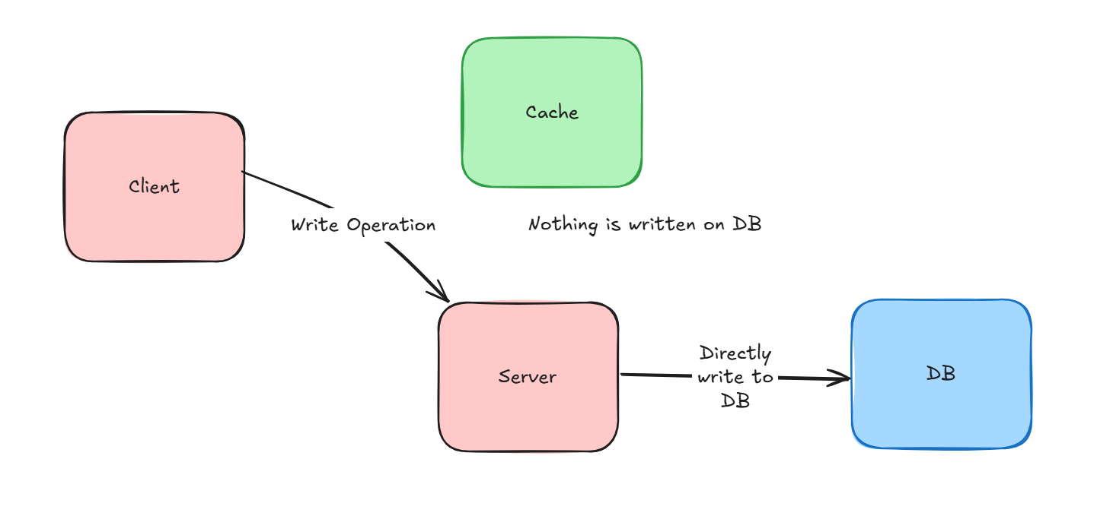
Write Only Method will always directly write to DB

Slide 58
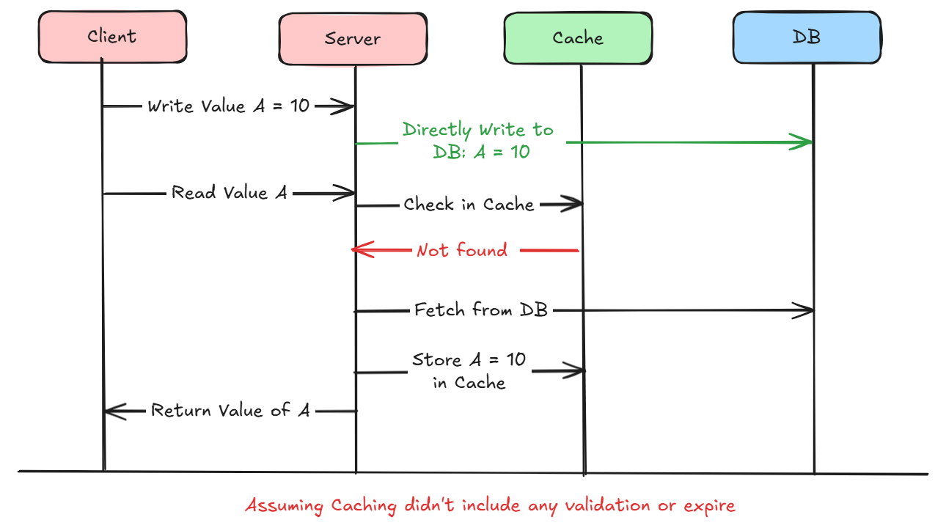
If appropriate caching is not used during write operation, there is a chance of inconsistency between Cache and DB

Slide 59
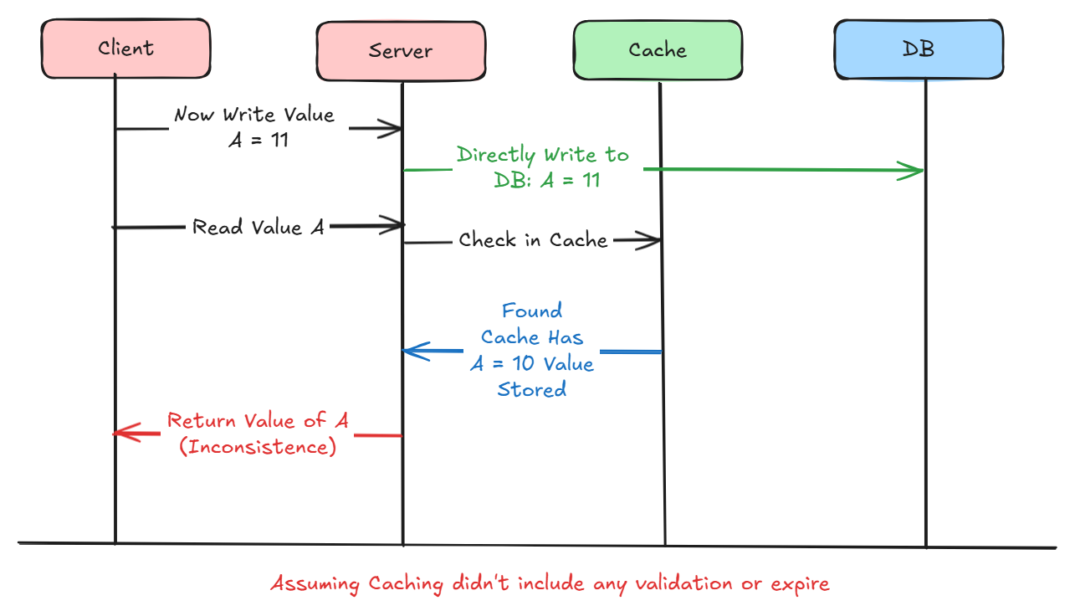
If appropriate caching is not used during write operation, there is a chance of inconsistency between Cache and DB

Slide 60
Read Through
Caching Strategy

Slide 61
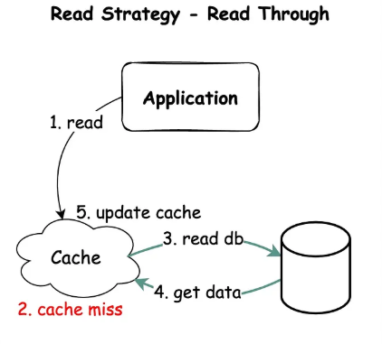
Read Through Strategy
First check cache for data
Cache Hit ! Return data to Client
Cache Miss !
Fetch data from DB
Store data in Cache
Return data to server

Slide 62
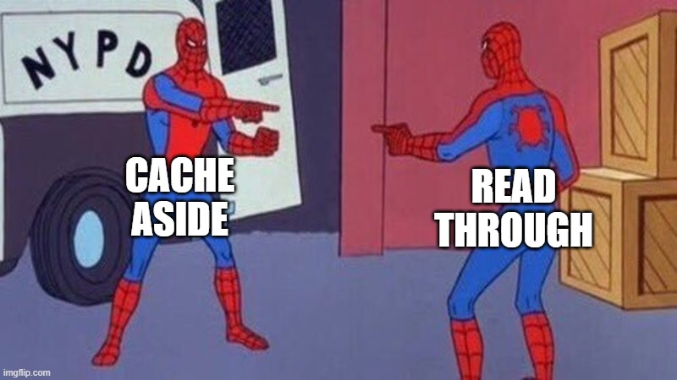
What’s the difference then?

Slide 63
What’s the difference then?
If cache miss, application or server takes the responsibility
Fetch data from DB
Store data in Cache
Return it to Client
( Server has to do all of this task)
If cache miss, cache library takes the responsibility
Fetch data from DB
Store data in Cache
Return it to server
( Server has no tasks to do here)
Cache Aside
Read Through

Slide 64

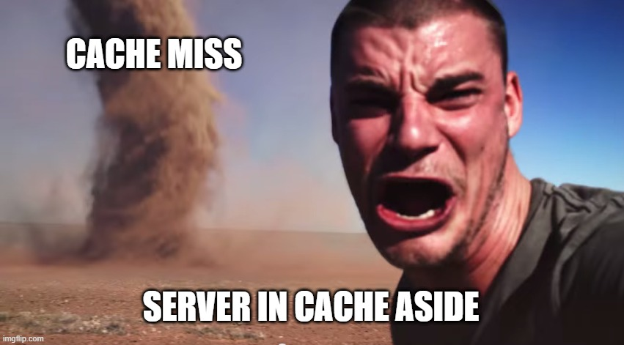
Notes:
Cache hit or Miss, Server no need to deal with it cause everything will be handled by Cache Library
If Cache Miss, now server has to do so many things fetching data and storing it in cache

Slide 65
What happens in Cache Hit? (Same)

Slide 66
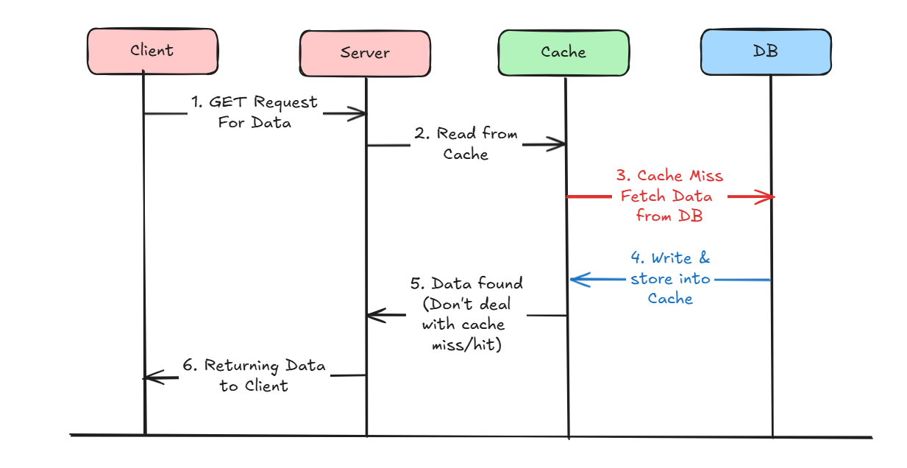
What happens in Cache Miss?

Slide 67
Read Through : Advantages
Good Approach for Heavy Read applications
Server don’t need to worry about whether it is a cache hit or miss
Offloads the responsibility from the application, resulting in simpler application code.

Slide 68
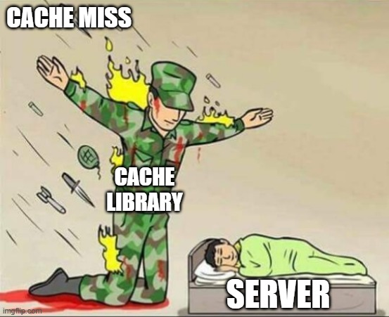
Server don’t need to worry about whether it is a cache hit or miss

Slide 69
Read Through : Cons
Write Only Method will always directly write to DB
For new data read, there will always be Cache - Miss first.
If appropriate caching is not used during write operation, there is a chance of inconsistency between Cache and DB

Slide 70
Read Through : Cons
Cache document data structure can not be different that data present in DB
If Cache goes down, request will fail, since the application interacts only with the cache.

Slide 71
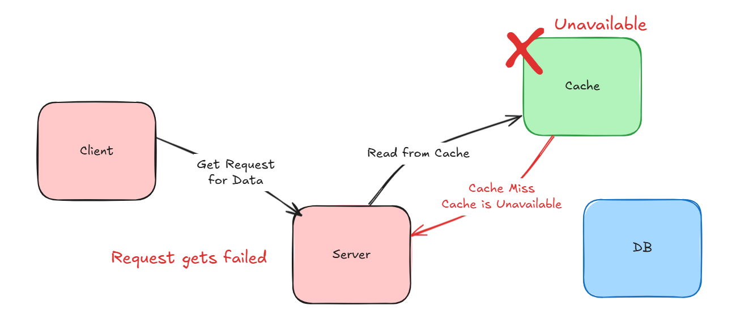
If Cache goes down, request will fail, since the application interacts only with the cache.

Slide 72

Cache document data structure can not be different that data present in DB
Database (Structured for Storage)
Cache (Optimized for Access)

Slide 73
Write Around
Caching Strategy

Slide 74
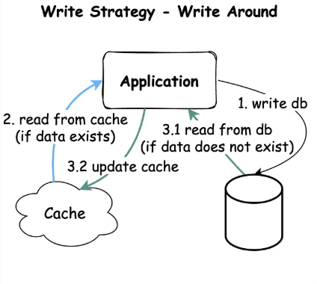
Write Around Strategy
Directly writes data into the database
For Read : Choose between
Cache Aside
Read Through

Slide 75
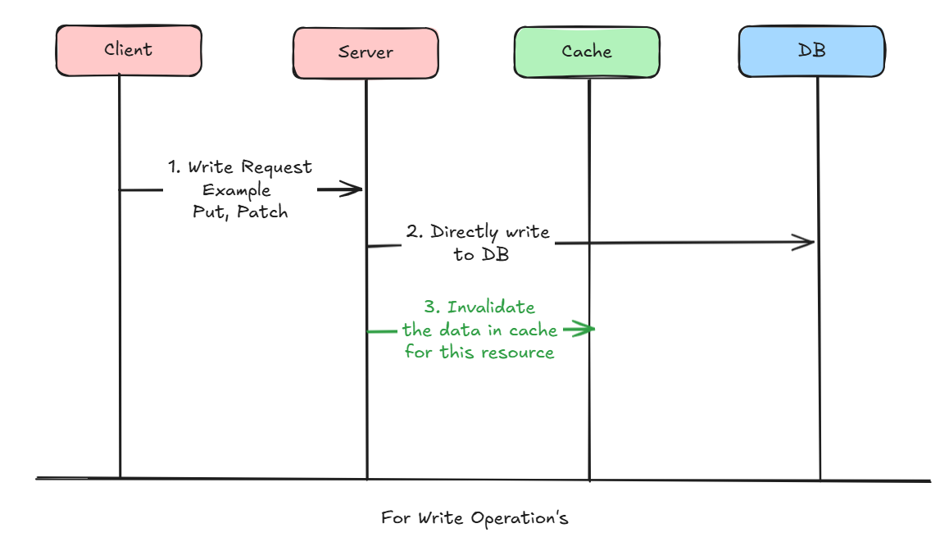
How write operation works?

Slide 76
What to do when read operations?
Have to choose a strategy between Cache Aside & Read Through

Slide 77
Combination of
Read : Cache Aside
Write : Write Around

Slide 78
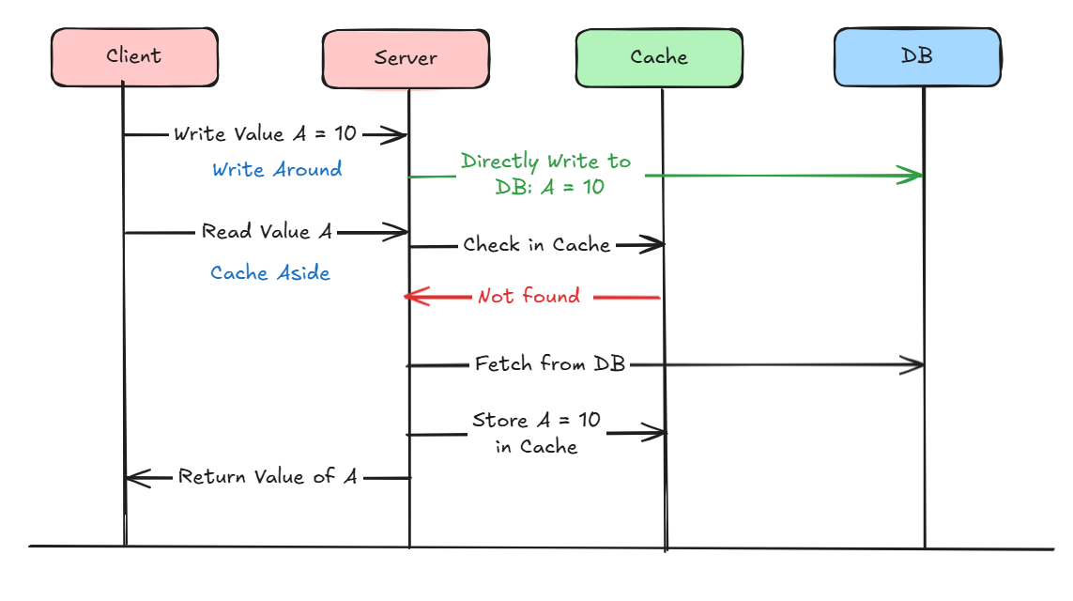
Combination of Cache Aside & Write Around Strategy

Slide 79
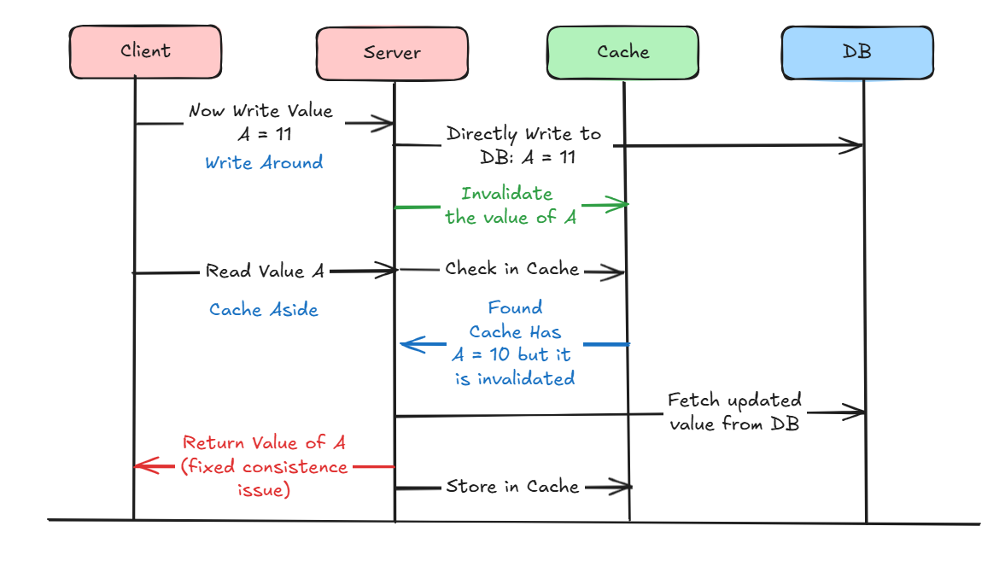
Combination of Cache Aside & Write Around Strategy

Slide 80
Write Around : Advantages
Good Approach for Heavy Read applications
Resolves the inconsistency problem between Cache and DB

Slide 81
Write Around : Cons
For new data read, there will always be Cache - Miss first.
If DB is down, request for write operation will fail

Slide 82
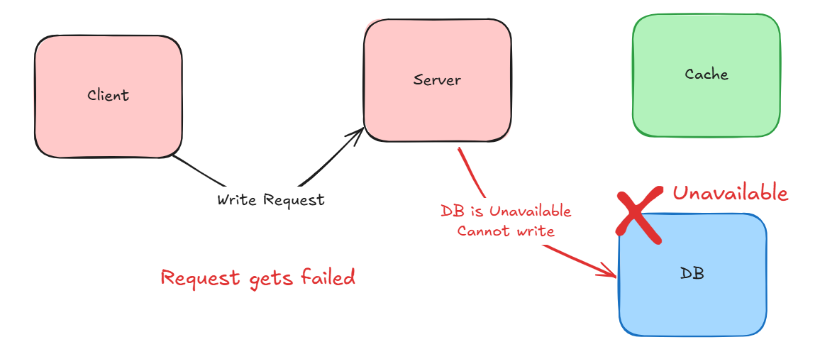
If DB is down, request for write operation will fail

Slide 83
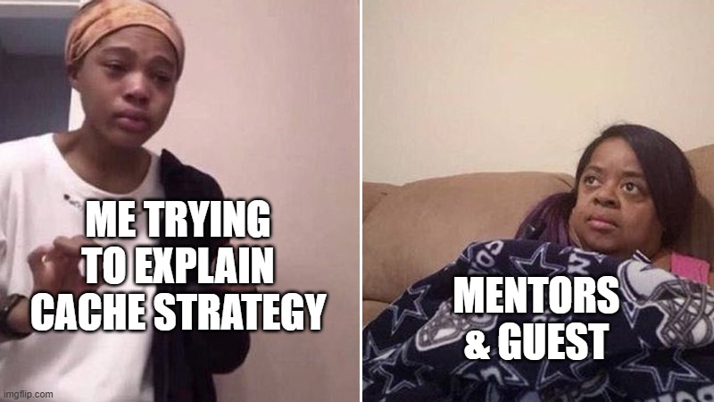

Slide 84
Write Through
Caching Strategy

Slide 85

Write Through Strategy
First writes data into the cache
Then in synchronous write data into the DB
For Read : Choose between
Cache Aside
Read Through

Slide 86

How write operation works?

Slide 87
What to do when read operations?
Have to choose a strategy between Cache Aside & Read Through

Slide 88
Write Through : Advantages
Resolves the inconsistency problem between Cache and DB
Increase Cache Hit chances : Even if for new data read there is a chance of cache hit

Slide 89

Increase Cache Hit chances : Even if for new data read there is a chance of cache hit

Slide 90
Write Through : Cons
If any of DB or Cache is Unavailable, request will fail.
2 phase commit, need to be applied to maintain transaction property

Slide 91

If DB is down, request for write operation will fail Even if cache is available

Slide 92

If Cache is down, request for write operation will fail Even if DB is available

Slide 93

Both Cache and DB must be available for successful operation

Slide 94
Write in Cache | Write in DB | Action Output
Successful | Failed (Unavailable) | Roll back write in cache
Failed (Unavailable) | Successful | Roll back write in DB
Successful | Successful | Okay !
2 phase commit, need to be applied to maintain transaction property

Slide 95


Slide 96
Write Back
Caching Strategy

Slide 97

Write Back Strategy
First writes data into the cache
Then in asynchronous write data into the DB
For Read : Choose between
Cache Aside
Read Through

Slide 98

How write operation works?

Slide 99
What to do when read operations?
Have to choose a strategy between Cache Aside & Read Through

Slide 100
Write Back : Advantages
Resolves the inconsistency problem between Cache and DB
Increase Cache Hit chances : Even if for new data read there is a chance of cache hit

Slide 101
Write Back : Advantages
Good for Write Heavy Applications
Improves the write operation latency as writing into DB happens asynchronously
Even if DB Fails, Write Operation will still works

Slide 102

Even if DB Fails, Write Operation will still works

Slide 103

Improves the write operation latency as writing into DB happens asynchronously

Slide 104
Write Back : Cons
Chance of issues when data is removed from cache and DB write still not happen yet
Write-back caching improves performance but risks data loss, complexity, and consistency issues

Slide 105


Slide 106


Slide 107


Slide 108


Slide 109
Caching in Modern Web
Accelerating Modern Web Technologies
K M Fatin Ishraq
Associate Software Engineer

Slide 110

Cache, We meet again!

Slide 111

What is PWA?
Progressive Web App.
Progressive? Fancy word!
But Why?
Notes:
Assalamu alaikum,
Good Afternoon,
Atikur Rahman
In today’s session we will go through REST API and RESTFulness.

Slide 112


Does this looks familiar?
Notes:
Assalamu alaikum,
Good Afternoon,
Atikur Rahman
In today’s session we will go through REST API and RESTFulness.

Slide 113

This One?
Can be installed simply by Add to home screen feature.
Notes:
Assalamu alaikum,
Good Afternoon,
Atikur Rahman
In today’s session we will go through REST API and RESTFulness.

Slide 114

We have got our own PWA!
The HR Portal acts as PWA.
Cefalo HR Management Portal
Notes:
Assalamu alaikum,
Good Afternoon,
Atikur Rahman
In today’s session we will go through REST API and RESTFulness.

Slide 115

So Why do we need PWAs?
PWAs’ actually good for businesses.
But why?
Notes:
Assalamu alaikum,
Good Afternoon,
Atikur Rahman
In today’s session we will go through REST API and RESTFulness.

Slide 116


PWA combines the best features of web and mobile apps.
FAST
Reliable
Engaging
Loads super fast!
Thanks to smart caching.
Works offline or even poor network connections.
Offer features like push notifications
Notes:
Start with Familiar Ground
"You're used to two main types of apps:
Web Apps: Open in your browser but need the internet to work.
Mobile Apps: Installed on your phone and work even without the internet."
Introduce the Problem PWAs Solve
"Wouldn't it be great if you could have the best of both worlds?
A website that loads instantly, even without the internet.
An app that doesn't take up much space on your phone but still feels like a real mobile app."
Define PWAs in Simple Terms
"That's exactly what Progressive Web Apps (PWAs) do!
They're websites that act like mobile apps.
You can add them to your home screen without downloading from an app store.
They load super fast, even offline, thanks to smart caching."
Explain How They Work (Without Too Much Jargon)
"When you visit a PWA, it saves important parts of the app (like images, code, and data) on your device.
Next time you visit, it shows you the saved version instantly, even if your internet is slow or disconnected.
Behind the scenes, it still checks for updates to make sure you get the latest content when you're online."
Use Everyday Examples
"Imagine using:
Twitter Lite (PWA): It loads instantly, lets you scroll through tweets, and even post one offline.
Starbucks: You can place an order even in areas with no network, and it syncs when you're back online.
Flipkart: Shop online without worrying about slow internet."
Highlight the Key Benefits
"With PWAs, you get:
Speed: They load fast and feel smooth, like mobile apps.
Offline Access: Works without the internet for many features.
No Installation Hassle: No app store, no downloads, just add to your home screen.
Low Storage Use: Unlike traditional apps, they take up very little space."
Finish with a Hook
"So, PWAs are the future of apps—a way to combine the simplicity of a website with the power of a mobile app, giving you the best of both worlds!"
This approach simplifies the concept of PWAs by drawing comparisons to familiar tools, focusing on the "why" before diving into the "how." Would you like to include any visuals or analogies to make this even clearer?

Slide 117

How is it different from traditional web app?
Notes:
Start with Familiar Ground
"You're used to two main types of apps:
Web Apps: Open in your browser but need the internet to work.
Mobile Apps: Installed on your phone and work even without the internet."
Introduce the Problem PWAs Solve
"Wouldn't it be great if you could have the best of both worlds?
A website that loads instantly, even without the internet.
An app that doesn't take up much space on your phone but still feels like a real mobile app."
Define PWAs in Simple Terms
"That's exactly what Progressive Web Apps (PWAs) do!
They're websites that act like mobile apps.
You can add them to your home screen without downloading from an app store.
They load super fast, even offline, thanks to smart caching."
Explain How They Work (Without Too Much Jargon)
"When you visit a PWA, it saves important parts of the app (like images, code, and data) on your device.
Next time you visit, it shows you the saved version instantly, even if your internet is slow or disconnected.
Behind the scenes, it still checks for updates to make sure you get the latest content when you're online."
Use Everyday Examples
"Imagine using:
Twitter Lite (PWA): It loads instantly, lets you scroll through tweets, and even post one offline.
Starbucks: You can place an order even in areas with no network, and it syncs when you're back online.
Flipkart: Shop online without worrying about slow internet."
Highlight the Key Benefits
"With PWAs, you get:
Speed: They load fast and feel smooth, like mobile apps.
Offline Access: Works without the internet for many features.
No Installation Hassle: No app store, no downloads, just add to your home screen.
Low Storage Use: Unlike traditional apps, they take up very little space."
Finish with a Hook
"So, PWAs are the future of apps—a way to combine the simplicity of a website with the power of a mobile app, giving you the best of both worlds!"
This approach simplifies the concept of PWAs by drawing comparisons to familiar tools, focusing on the "why" before diving into the "how." Would you like to include any visuals or analogies to make this even clearer?

Slide 118


Let’s put it simply!
The browser requests resources from the server.
Service Worker Intercepts!
First Load -> Resources are fetched from the server.
Subsequent loads -> Use Cache!
When offline -> Use content from cache
Notes:
Assalamu alaikum,
Good Afternoon,
Atikur Rahman
In today’s session we will go through REST API and RESTFulness.

Slide 119

Key characteristics of PWAs
Service Workers: The Mastermind!
Background scripts that enable caching, offline functionality and push notifications.
A JSON file that allows users to install PWAs on their devices
Notes:
{
"name": "My Awesome App",
"short_name": "AwesomeApp",
"description": "An app to make your tasks awesome and organized.",
"icons": [
{
"src": "/images/icon-192x192.png",
"sizes": "192x192",
"type": "image/png"
},
{
"src": "/images/icon-512x512.png",
"sizes": "512x512",
"type": "image/png"
}
],
"start_url": "/index.html",
"display": "standalone",
"scope": "/",
"theme_color": "#4CAF50",
"background_color": "#ffffff",
"orientation": "portrait",
"lang": "en-US",
"dir": "ltr"
}

Slide 120

Let’s get technical!
Service Worker Caching
The service worker cache provides more fine-grained control over what is cached and how, compared to the HTTP cache.

Slide 121

Caching strategies of PWA
Cache First, Network Fallback
Serves cached content first, falls back to network if unavailable.
Best for static resources like images, CSS, or fonts.
Offers fast load times but risks serving outdated data.
Notes:
Assalamu alaikum,
Good Afternoon,
Atikur Rahman
In today’s session we will go through REST API and RESTFulness.

Slide 122

Caching strategies of PWA
Network First, Cache Fallback
Fetches fresh content from the network uses cache only if the network fails.
Ideal for real-time APIs or frequently updated data.
Ensures freshness but can be slower and dependent on network availability.
Notes:
Assalamu alaikum,
Good Afternoon,
Atikur Rahman
In today’s session we will go through REST API and RESTFulness.

Slide 123

Caching strategies of PWA
Stale While Revalidate
Serves cached content immediately and updates cache in the background.
Suitable for non-critical data
Balances speed with relatively fresh data but may show outdated content briefly.
Notes:
like blog posts or product descriptions.

Slide 124

Overview of the process

Slide 125

Twitter PWA

Slide 126

So what happened after this?
Problems
Slow on mobile networks
Used storage more
Low user engagement on mobile devices
After PWA
Instant Loading
Lower data consumption
Only 600 KB in app size

Slide 127

Starbucks PWA
Storing Menu Items and Customizations
Service Workers Updating in the background!

Slide 128

So that’s why they want it!

Slide 129

Let’s differentiate
Checks All the boxes!
(Cause I have added only the checked boxes of PWA.)

Slide 130

AMP
Accelerated Mobile Pages (AMP) is an open-source project by Google aimed at creating fast-loading mobile web pages.

Slide 131

AMP Pages

Slide 132

AMP HTML
Platforms like Google Search identify AMP pages using <html ⚡> or <html amp> tags and automatically add them to the AMP Cache after crawling.

Slide 133

AMP JS
amp-script lets you write and run your own JavaScript in a way that maintains AMP's performance guarantees.

Slide 134

So What is an AMP Cache?
An AMP Cache is a proxy-based content delivery network (CDN) for delivering valid AMP documents. AMP Caches are designed to:
Serve only valid AMP pages.
Allow AMP pages to be preloaded efficiently and safely.
Perform additional user-beneficial performance optimizations to content.

Slide 135

How does my AMP page get cached?
Platform Discovery
Cache URL Request
Publisher Addition
Notes:
Platform Discovery: Platforms like Google Search identify AMP pages using <html ⚡> or <html amp> tags and automatically add them to the AMP Cache after crawling.
Cache URL Request: Platforms can directly request AMP content using the AMP Cache URL format (e.g., https://foo-com.cdn.ampproject.org/c/s/foo.com/amp_document.html).
Publisher Addition: Publishers have the option to proactively add AMP pages to the Google AMP Cache for faster availability and update

Slide 136
AMP in Washington Post
23%
88%
1000+
Improvement in load time for AMP content versus traditional mobile web
Articles the Washington Post publishes in AMP HTML daily
Increase in mobile search users who return within 7 days
From amp.dev

Slide 137


Slide 138

That’s why this happens!

Slide 139

Thank you for bearing with us for so long.

Slide 140


Slide 141
References (Caching Basics)
https://developer.mozilla.org/en-US/docs/Web/HTTP/Caching
https://nitropack.io/blog/post/web-caching-beginners-guide
https://www.mnot.net/cache_docs/
https://tomayko.com/blog/2008/things-caches-do

Slide 142
References (Caching Strategy)
https://youtu.be/RtOyBwBICRs?si=IrqpxAe4-qnbXMZB
https://blog.bytebytego.com/p/top-caching-strategies
https://blog.algomaster.io/p/top-5-caching-strategies-explained
https://codeahoy.com/2017/08/11/caching-strategies-and-how-to-choose-the-right-one/
https://youtu.be/2zIFUqTx_TU?si=jeT9xfqCpSKMQ2F4
https://wp-rocket.me/wordpress-cache/different-types-of-caching/
https://youtu.be/m7mPhY95uVg?si=PR8oM0TgRYUgA1O4

Slide 143
References (Caching in Modern Web- PWA)
https://developer.chrome.com/docs/workbox/caching-strategies-overview
https://pagepro.co/blog/what-is-pwa/
https://medium.com/animall-engineering/best-caching-strategies-progressive-web-app-pwa-c610d65b2009
https://alokai.com/blog/pwa
https://anuradha.hashnode.dev/role-of-service-worker-in-pwas
https://www.zignuts.com/blog/what-is-pwa
https://simicart.com/blog/pwa-service-worker/
https://clevertap.com/blog/progressive-web-apps/
https://web.dev/articles/service-worker-caching-and-http-caching

Slide 144
References (Caching in Modern Web- AMP)
https://amp.dev/documentation/guides-and-tutorials/develop/custom-javascript#enhance-amp-components
https://amp.dev/success-stories/washingtonpost
https://instapage.com/blog/amp/
https://www.tigren.com/blog/pwa-vs-amp/

Slide 145


